Slide 1

CargoMind AI - Intelligent Container Yard Optimization
AI-powered container terminal management system for optimal storage
By
Mohamed Humaid Zahir Hussain
Naveen K

Slide 2



Problem Statement
Container yards face complex storage decisions because containers must be positioned while considering space, weight, priority, hazards, reefer requirements, and future retrieval.
Existing Challenges
  Manual container placement decisions
  Inefficient yard utilization
  Excessive crane movement
  Container reshuffling
  Difficult retrieval of priority containers
  Multiple operational constraints
  Increasing yard complexity
OPERATIONAL COST

Slide 3


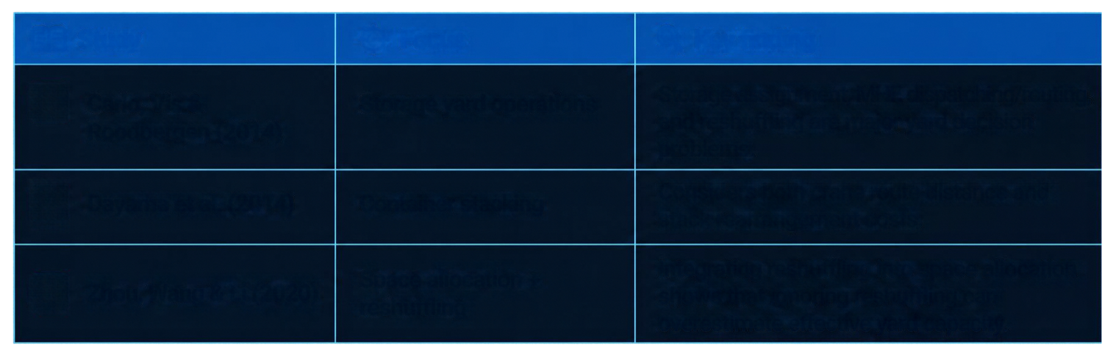






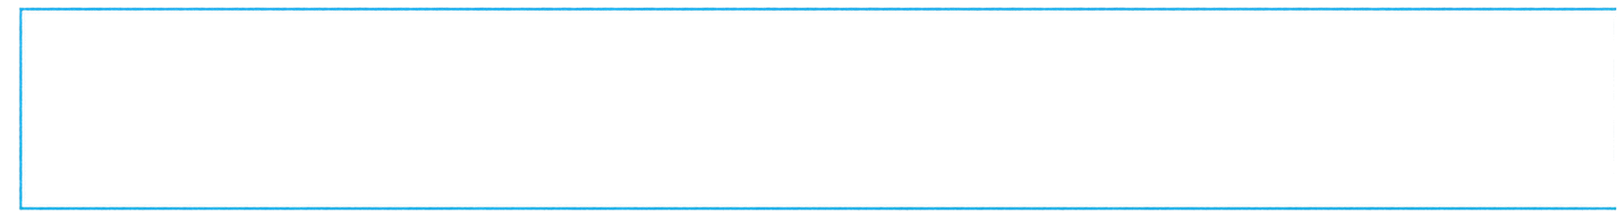

Literature Survey
Selected studies
Study
Focus
Key finding
1.
Carlo, Vis & Roodbergen (2014)
Storage yard operations
Storage assignment, MHE dispatching/routing, and reshuffling are major yard decision problems.
Considers both crane route distance and stack rearrangement costs.
2.
Dayama et al. (2014)
Container stacking
Space allocation + reshuffling
Integrating reshuffling into space allocation shows that ignoring reshuffling can overestimate effective yard capacity.
3.
Zhou, Wang & Li (2020)
Existing research provides strong optimization models for specific yard decisions, but there is an opportunity to combine multiple AI decision mechanisms into one practical decision-support application.

Slide 4











Research Gap
EXISTING APPROACHES
PROPOSED GAP ADDRESSED
Focus on individual problems
SEARCH
CONSTRAINT SATISFACTION
OPTIMIZATION
RULE-BASED REASONING
SIMULATION
Separate reshuffling logic
Limited AI integration
UNIFIED AI RECOMMENDATION ENGINE
Little explainability
“A modular AI decision-support framework with explainable recommendations and scenario simulation.”

Slide 5









Research Objectives
Develop AI-based system for efficient, constraint-compliant container placement
1
Optimize storage slot and stack selection
2
Reduce crane movement distance
3
Minimize reshuffling operations
4
Enforce operational constraints (stack height, weight, hazard, reefer, reserved areas)
5
Explain decision confidence and reasoning
6
Evaluate scenarios via simulation

Slide 6






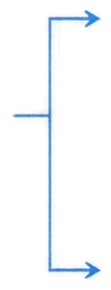









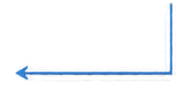

Proposed System Architecture
AI-powered cargo terminal management from data to decision.
USER INTERFACE
BACKEND SERVICE
AI ENGINE
RECOMMENDATION
React + TypeScript
+ Tailwind
FastAPI
BFS |DFS | UCS | A*
CSP | Optimization | Simulation
Optimal Slot Plan
Rationale
Impact Summary
USER
Authentication
Dashboard
Terminal Planner
or Operator
Slot Visualization
Business Logic
Scenario Input
REST APIs
DATABASE
USER APPROVAL
SQLite | PostgreSQL| SQLAlchemy
Review Plan
Approve or Adjust
Execute
Results & Insights
Data Validation
ANALYTICS & REPORTS
KPIs | Performance Trends | Operational Insights | Charts
DATA FLOW
DECISION FLOW

Slide 7










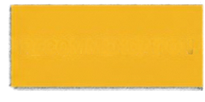





Algorithms Used
SEARCH ALGORITHMS
CONSTRAINT & REASONING
OPTIMIZATION
SIMULATION
BFS
Hill Climbing
CSP
Arrival
DFS
Simulated Annealing
Constraint Propagation
Retrieval
UCS
Forward/Backward Chaining
Yard Rearangement
A*
Rule Engine
Algorithm Comparison
CANDIDATE SLOTS
CONSTRAINT FILTERING
SEARCH
OPTIMIZATION
COST EVALUATION
RECOMMENDATION

Slide 8













Implementation
01
AUTHENTICATION
React 19, TypeScript, Vite Tailwind CSS, React Router Axios, Chart.js
02
CONTAINER MANAGEMENT
FRONTEND
03
SHIPMENT & VESSEL
Python, FastAPI, Uunicorn SQLAlchemy, Pydantic Alembic, JWT Auth
BACKEND
04
YARD MANAGEMENT
05
AI RECOMMENDATION
AI ENGINE
Custom search, NumPy NetworkX, OR-Tools scikit-learn
06
SIMULATION
DATABASE
SQLite (local)
PostgreSQL (production)
07
ANALYTICS & REPORTS

